Slide 1

Green Pace
Security Policy Presentation
Developer: Natalia A. Santiago
[Complete this template by replacing the bracketed text with the relevant information.]

Slide 2

OVERVIEW: DEFENSE IN DEPTH
Our Green Pace security policy is designed to create a solid framework for protecting our systems and data from possible dangers. This policy is important to make sure that there is adherence to standardized procedures by all developers, securing a uniform approach towards security. Through its adoption, we establish a defense-in-depth program that adds layers of multiple security measures to protect against numerous vulnerabilities.
As our development team expands, having explicit and reproducible security guidelines is crucial to ensure consistency in our practice. This policy closes the gap between tacit practice and formalized procedure, getting everyone in the team reading from the same script. The background for the necessity of this policy was the growing complexity of our projects and the changing face of cybersecurity threats.
The defense-in-depth principle involves multiple layers of security controls for redundancy and to mitigate the risk of a single point of failure. Our policy is tailored to meet the various levels, right from the physical security to as high as application security, so that everything is comprehensively covered. Standardizing our practice will enable us to detect, prevent, and respond to any threat better and enhance the security posture of our company overall. The figure on this slide illustrates graphically the different layers of the defense-in-depth strategy, emphasizing the requirement for an integrated approach to cybersecurity.

Slide 3
THREATS MATRIX
Explanations
Phishing attacks targeting employees: These are common and can lead to significant breaches if employees inadvertently disclose sensitive information.
Social engineering exploits: Attackers often use psychological manipulation to gain access to systems.
Unauthorized access due to weak password policies: Ensuring strong password policies and multi-factor authentication is critical to prevent unauthorized access.
Data breaches involving sensitive user information: Protecting user data should be a top priority, as breaches can have severe consequences.
Injection attacks (SQL injection, etc.): These attacks can compromise databases and expose sensitive data.
Cross-site scripting (XSS) vulnerabilities: These can allow attackers to inject malicious scripts into web pages, affecting users' browsers.
Physical theft of office equipment: While less common, this can still result in the loss of sensitive data if devices are not properly secured.
Network disruptions due to minor hardware failures: While these are low priority, they can still cause temporary disruptions.
Natural disasters affecting data centers: Although unlikely, natural disasters can cause significant damage if proper disaster recovery plans are not in place.
Zero-day vulnerabilities exploited in the wild: These are rare but can be highly damaging if not addressed promptly.
Likely Phishing attacks targeting employees Social engineering exploits Unauthorized access due to weak password policies | Priority Data breaches involving sensitive user information Injection attacks (SQL injection, etc.) Cross-site scripting (XSS) vulnerabilities
Low priority Physical theft of office equipment Network disruptions due to minor hardware failures | Unlikely Natural disasters affecting data centers Zero-day vulnerabilities exploited in the wild

Slide 4
10 PRINCIPLES
1. Principle of Least Privilege
Coding Standard: Ensure that each component has only the minimal privileges necessary to perform its function.
2. Defense in Depth
Coding Standard: Implement multiple layers of security controls to protect against various threats.
3. Secure Defaults
Coding Standard: Configure systems and software to have the most secure settings by default.
4. Fail Securely
Coding Standard: Ensure that systems fail in a secure manner, preventing unintended access in the event of failure.
5. Open Design
Coding Standard: Use open and peer-reviewed security mechanisms rather than relying on obscurity for security.
6. Separation of Duties
Coding Standard: Divide tasks and privileges among multiple components to limit the risk of misuse.
7. Keep Security Simple
Coding Standard: Avoid unnecessary complexity in security mechanisms, as complexity can lead to vulnerabilities.
8. Minimize Attack Surface
Coding Standard: Reduce the number of entry points and exposed interfaces to minimize potential attack vectors.
9. Assume Breach
Coding Standard: Design systems with the assumption that a breach can occur, and implement measures to detect, respond to, and recover from breaches.
10. Continuous Security Assessment
Coding Standard: Regularly conduct security assessments and audits to identify and address vulnerabilities.

Slide 5
CODING STANDARDS
Data Encryption is the top priority because protecting sensitive data is crucial for maintaining confidentiality and integrity. Encryption ensures that even if data is intercepted, it remains unreadable to unauthorized parties.
Input Validation is next because preventing injection attacks like SQL injection is vital to safeguard databases and applications from unauthorized access and manipulation.
Authentication and Authorization are essential for controlling access to systems and data. Strengthening these mechanisms helps prevent unauthorized users from gaining access.
Error Handling is prioritized to ensure that error messages do not reveal sensitive information that could aid attackers.
Session Management is critical to prevent session hijacking and ensure that user sessions are securely managed.
Secure Configuration of systems minimizes vulnerabilities by applying secure settings and reducing the attack surface.
Regular Updates and Patch Management are necessary to fix known vulnerabilities and prevent exploitation by attackers.
Code Reviews and Audits help identify and fix security issues in the code, ensuring higher code quality and security.
Logging and Monitoring are important for detecting and responding to security incidents in a timely manner.
Security Training and Awareness are essential for creating a security-conscious culture among developers and staff, reducing the likelihood of human errors and security breaches.

Slide 6
ENCRYPTION POLICIES
Encryption in Flight: Encryption in flight refers to protecting data as it is transmitted over networks. The policy mandates the use of strong encryption protocols, such as TLS (Transport Layer Security), to ensure that data cannot be intercepted or tampered with during transmission. This helps maintain the confidentiality and integrity of data as it moves between systems, users, and devices.
Encryption at Rest: Encryption at rest involves securing data stored on disks, databases, and other storage media. The policy requires the use of encryption algorithms like AES (Advanced Encryption Standard) to protect sensitive data from unauthorized access. This ensures that even if physical storage devices are compromised, the data remains inaccessible without the proper decryption keys.
Encryption in Use: Encryption in use focuses on protecting data while it is being processed or actively used by applications. This policy encourages the use of techniques such as homomorphic encryption or secure enclaves to safeguard data during computation. The goal is to prevent exposure of sensitive information while it is being manipulated in memory or processed by applications.

Slide 7
TRIPLE-A POLICIES
Authentication: The authentication policy mandates the use of strong, multi-factor authentication (MFA) methods to verify the identity of users accessing systems and applications. This includes the use of passwords, biometric verification, and one-time passcodes. The goal is to ensure that only legitimate users can access sensitive data and systems. Additionally, the policy requires periodic review and updates of authentication mechanisms to stay ahead of evolving security threats.
Authorization: The authorization policy outlines the principles of least privilege and role-based access control (RBAC) to manage user permissions. This ensures that users only have access to the resources necessary for their specific roles and responsibilities. Access rights are regularly reviewed and updated to reflect changes in job functions or organizational structure. The policy also includes procedures for granting, modifying, and revoking access rights in a timely manner.
Accounting: The accounting policy focuses on logging and monitoring user activities to maintain an audit trail. This includes recording login attempts, access to sensitive data, and changes to system configurations. The policy requires that logs are regularly reviewed and analyzed to detect any suspicious or unauthorized activities. Automated tools and alerts are used to identify potential security incidents, enabling prompt response and investigation.

Slide 8
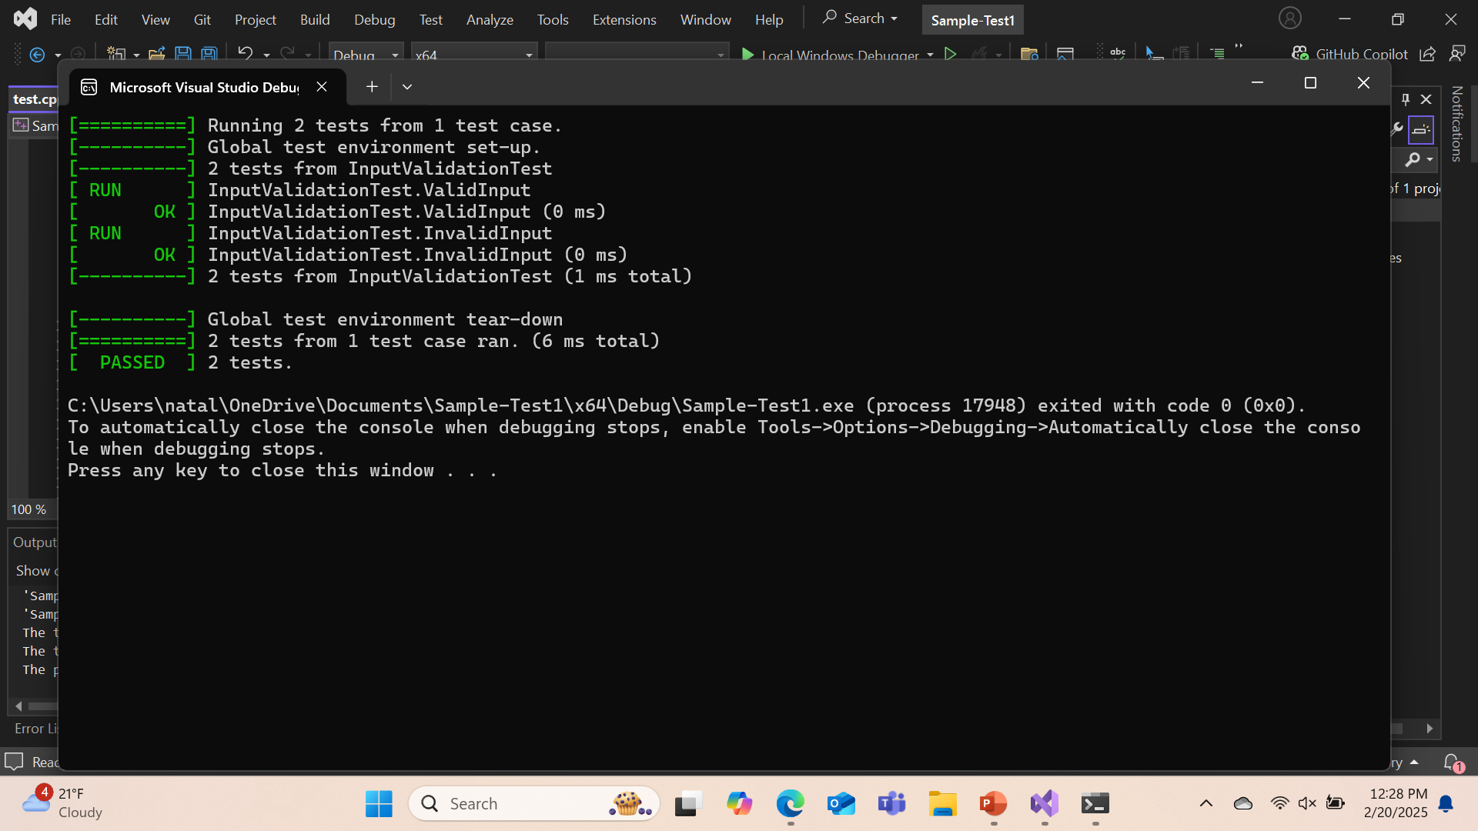
Unit Testing
Test 1: Input Validation
Objective: Verify that input validation mechanisms are correctly implemented to prevent injection attacks.
Taking It Further:
Implement boundary value analysis to test edge cases.
Add tests for different input types (e.g., alphanumeric, special characters).
Use fuzz testing to generate random and unexpected inputs.

Slide 9
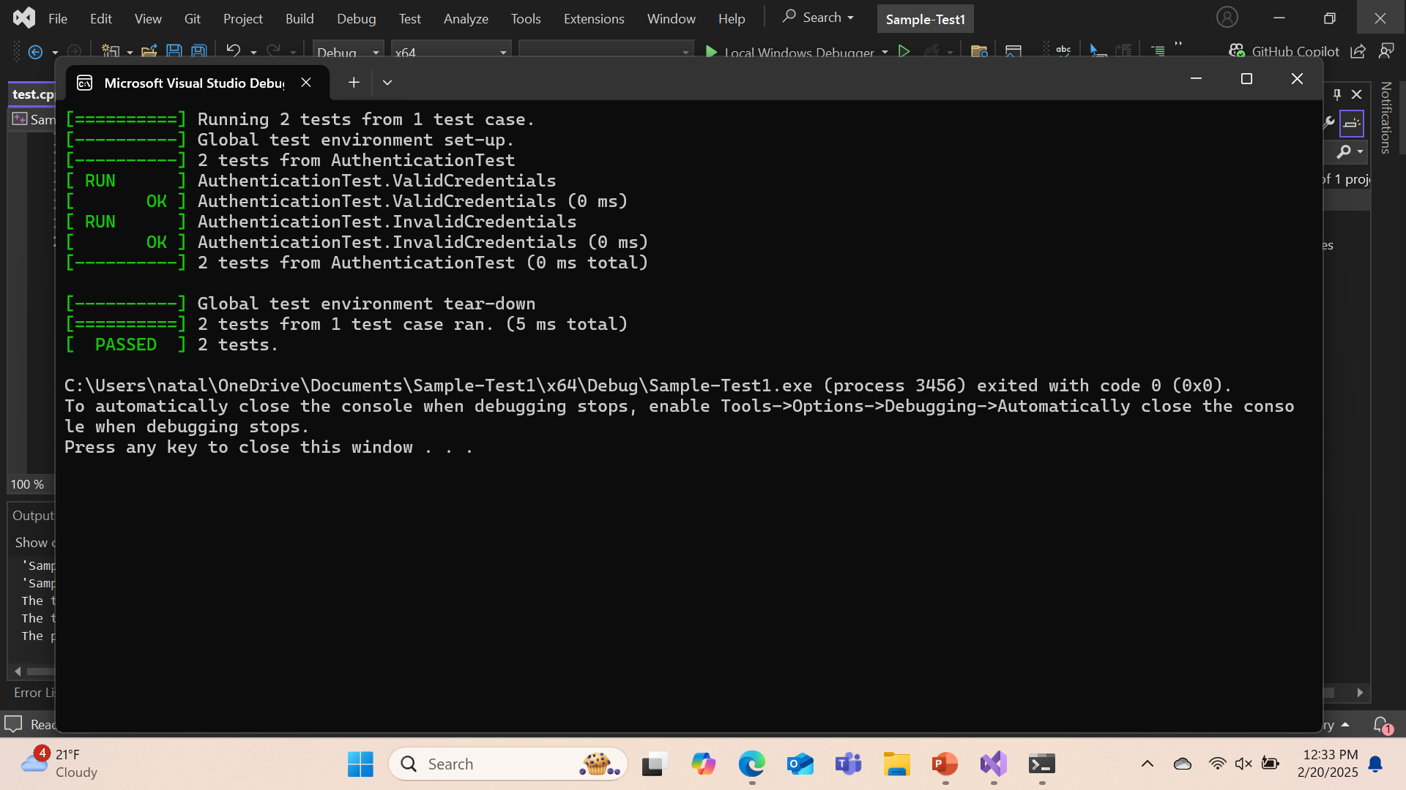
Unit Testing
Test 2: Authentication
Objective: Ensure that authentication mechanisms function correctly and securely.
Taking It Further:
Test multi-factor authentication scenarios.
Simulate brute-force attacks to verify lockout mechanisms.
Include tests for different user roles and permissions.

Slide 10
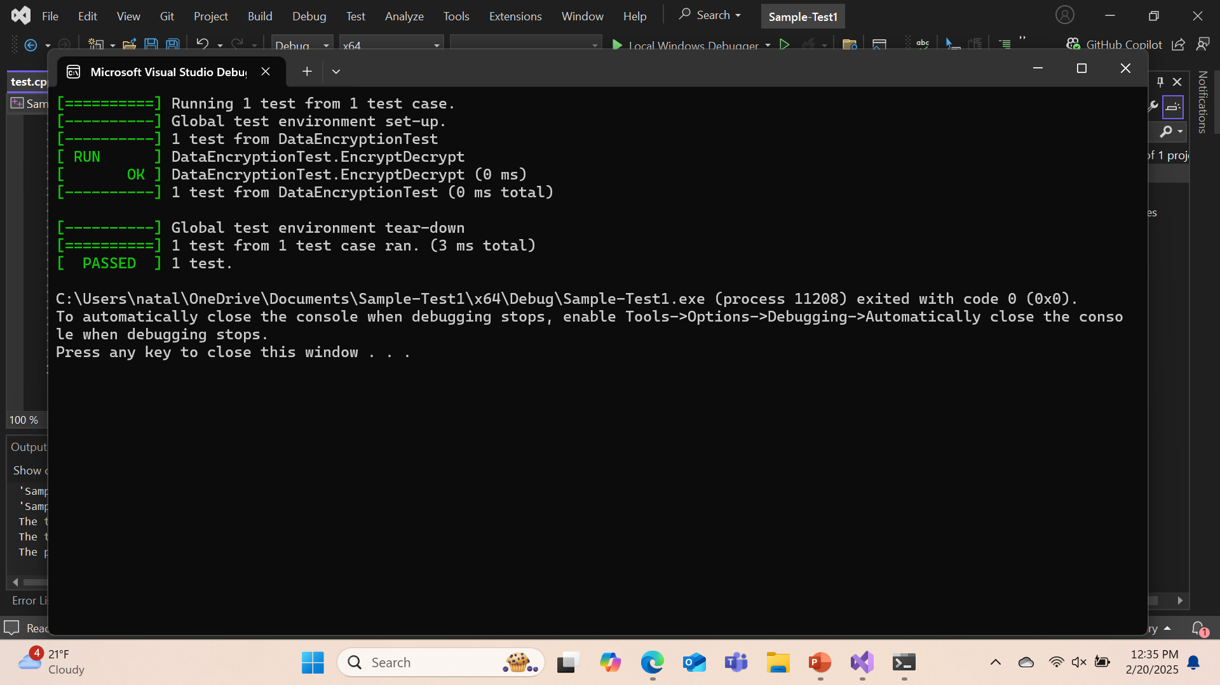
Unit Testing
Test 3: Data Encryption
Objective: Validate that data encryption mechanisms are correctly implemented.
Taking It Further:
Test encryption and decryption of various data types.
Verify that encrypted data cannot be easily deciphered without the key.
Implement tests for different encryption algorithms.

Slide 11
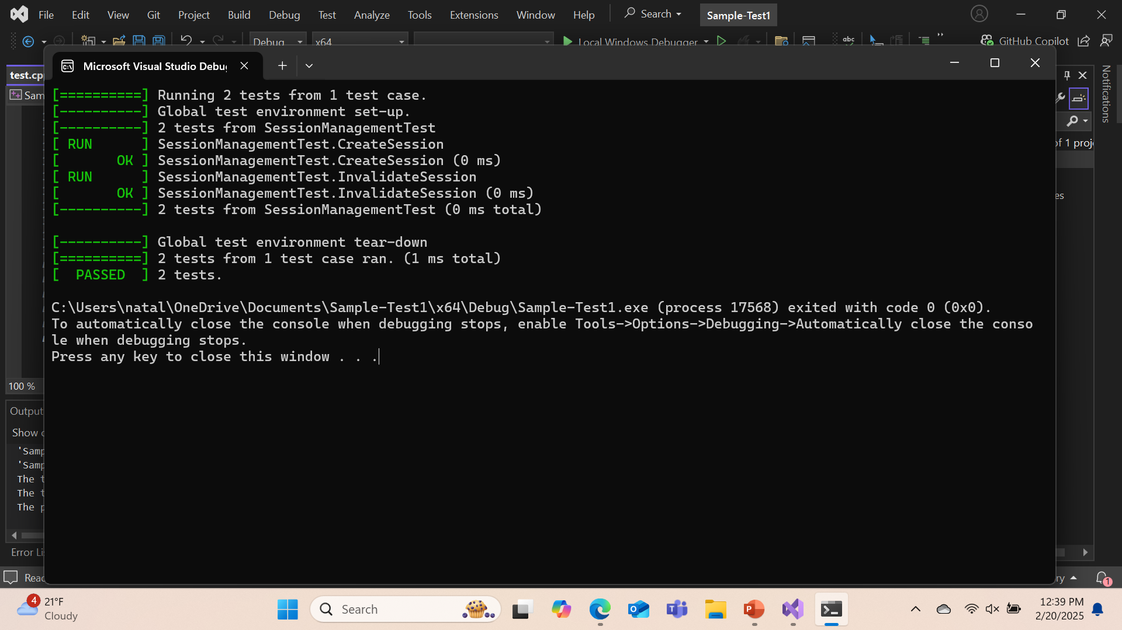
Unit Testing
Test 4: Session Management
Objective: Ensure that session management mechanisms are secure and function correctly.
Taking It Further:
Add test cases for different user roles and permissions to ensure that sessions are managed appropriately for each role.

Slide 12

AUTOMATION SUMMARY

Slide 13
TOOLS
In a DevSecOps pipeline, security tools are integrated at each stage to ensure continuous protection. During planning, tools assess dependency risks and threat models; in coding, static code analysis (SAST) and secret scanning detect vulnerabilities. At build, vulnerability scanning, container scans, and further static analysis occur. In testing, dynamic testing (DAST) and interactive analysis (IAST) identify runtime issues, while release focuses on scanning configurations and ensuring security compliance. Deployment relies on tools like Runtime Application Self-Protection (RASP) and Security Information and Event Management (SIEM) for monitoring, and in operations, continuous monitoring, vulnerability management, and automated incident response are applied. The compiler’s role is in the build stage, converting source code to executable code, while security tools focus on pre- and post-compilation scanning.

Slide 14
RISKS AND BENEFITS
The main problems of not integrating security early in the DevSecOps pipeline include increased vulnerabilities, higher remediation costs, and potential non-compliance with regulations. The solution is to implement security automation tools at every stage, from planning through deployment and operation, to proactively identify and address risks. Acting now offers the benefits of early risk mitigation, lower costs, and improved compliance, while waiting exposes the organization to greater vulnerabilities, more expensive fixes, and reputational damage due to security breaches or non-compliance.

Slide 15
RECOMMENDATIONS
The current security policy may have gaps in integrating security throughout the entire DevSecOps pipeline, such as lack of automated tools for continuous vulnerability scanning, insufficient testing for runtime security issues, or limited compliance checks in the release and deployment stages. For example, many organizations still perform security checks only at the end of the development cycle, which can lead to costly vulnerabilities found too late, as seen with the 2017 Equifax breach, where vulnerabilities were discovered long after they had been exploited. To improve, security tools should be integrated from the planning phase onward, with automated scans and real-time monitoring throughout development, build, test, and deployment stages. Additionally, continuous updates to address emerging threats and regulatory changes should be incorporated to reduce risk, improve compliance, and enhance overall security posture.

Slide 16
CONCLUSIONS
To prevent future problems, organizations should adopt standards such as the OWASP Top Ten for secure coding practices, ISO/IEC 27001 for information security management, and NIST Cybersecurity Framework for risk management. Additionally, implementing CI/CD security automation (e.g., automated SAST, DAST, and dependency checks) ensures vulnerabilities are identified early in the development cycle. Organizations should also enforce security by design, ensuring that security is integrated from the start, and adopt DevSecOps practices to continuously monitor, test, and patch vulnerabilities throughout the entire software development lifecycle. Regular audits, compliance checks, and keeping up with evolving regulations will further strengthen the security posture.

Slide 17
REFERENCES
ISO - International Organization for Standardization. (2019, August 6). ISO/IEC 27001:2013. ISO. https://www.iso.org/standard/54534.html
NIST. (2018). Framework for Improving Critical Infrastructure Cybersecurity, Version 1.1. Framework for Improving Critical Infrastructure Cybersecurity, 1.1(1). https://doi.org/10.6028/nist.cswp.04162018
OWASP. (2021). OWASP Top Ten. Owasp.org; OWASP. https://owasp.org/www-project-top-ten/

